Slide 1
Ecosystem and Biodiversity

Slide 2
Ecology
The word ecology is derived from Greek word ‘Oekologic’. Oikos means ‘habitation’ or ‘house’ and logos means study.
It was first coined by the German biologist Ernst Haeckel in 1886, who defined it as “The comprehensive science of the relationship of the organism to the environment”.
It can also be defined as “ The scientific study of the relationship of living organism with each other and with their environment”.
“We are all in it together”
Notes:
2
Ecology is essentially the study of living organisms and their environment. One aspect of this study is the biology and the chemistry of the organism and their environment. But the other aspect is from a system dynamics perspective, where we are interested in how the system distributes energy and nutrients through it to enable life. We will be looking at the later aspect in more detail in this class.

Slide 3
Ecosystem
Definition: The living community of plants and animals (Biotic) in any area together with the non-living components of the environment such as soil, air and water (Abiotic) constitute the ecosystem
It is also defined as a Natural unit of living organisms and their non-living environment that interact to form a stable system.
Notes:
Here’s the definition of an ecosystem. One thing to notice here is that the definition does not include a sense of scale. This is very important. An ecosystem does not have a scale. It could be something as small as a puddle/small pond to the entire planet. It all depends on what one is trying to understand. A large ecosystem like a forest or an ocean where large number of flora and fauna live in their environment is usually defined as a biome.

Slide 4
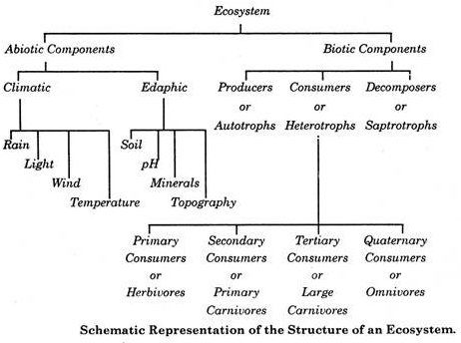
STRUCTURE OF AN ECOSYSTEM
theintactone.com
Notes:
An ecosystem can be broken down to two key components: The biotic and abiotic components. The biotic components include all the living things in the ecosystem and the abiotic components include various aspects of the non-living environment. Both are dynamic components as they are ever changing.

Slide 5
Functions of an ecosystem
Major functional attributes of ecosystem are
Energy Flow
Nutrients cycling
Productivity and decomposition
Development and stabilization
Notes:
The primary functions of an ecosystem have to do with distribution of energy and nutrients through it. Those factors combined with climate, geography, biological productivity (for example, the diversity of flora growing or the amount of tree cover in an area) of the area and the rate of decomposition lead to formation of “niches” (pronounced “neeshes”) which enable development of life in the ecosystem. Once all the niches of an ecosystem are filled, the degree of diversity stabilizes. We will now discuss what is an ecological niche.

Slide 6
Ecological Niche
An Ecological niche is the match of a species to a specific environmental condition
Pocheville, Arnaud (2015)
Notes:
To understand how ecosystems function, we need to understand the idea of an ecological niche. If two forms of life live in the same area, and have similar needs, then they will compete each other for resources. When two or more species compete, eventually some of these species will be driven away, or go extinct. As a result, in any place, only one species occupies a niche in the ecosystem: Two different forms of life can live in the same place, but only if they have different roles. e.g. They hunt at different times of the day or eat different foods. The word niche comes from French term “nicher” which means to make nest. Life will evolve to take advantages of niches that it can decipher in an ecosystem. Sharing a niche implies constant competition which is not ideal for survival. Next, we will look at some examples of ecological niches.

Slide 7
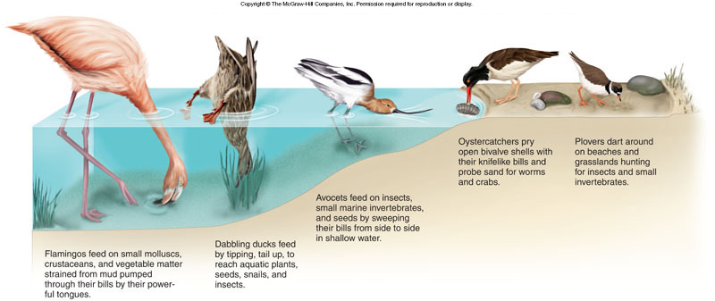
Ecological Niche- Wading Birds
Notes:
Here is an example of various wading birds occupying various ecological niches. Waders are a type of birds which wade into water to get food from the mud/sand underneath. You can clearly see that each wader has specialized to take advantage of its own ecological niche. If two waders occupy the same niche, they will be directly in competition with each other, resulting in one of them either being driven away or going extinct.

Slide 8
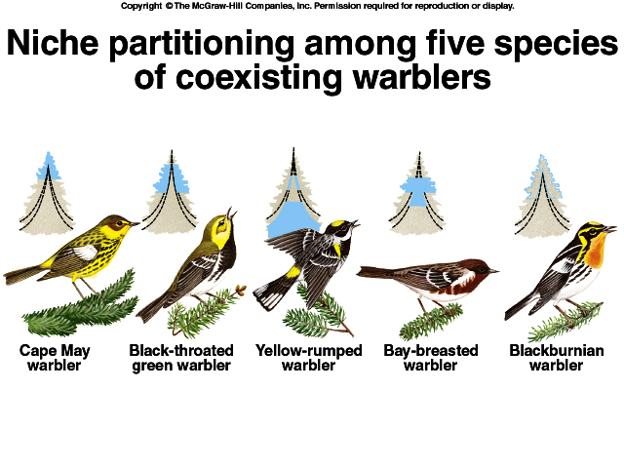
Kaspari, M. (2008). Knowing your warblers: thoughts on the 50th anniversary of MacArthur (1958). The Bulletin of the Ecological Society of America, 89(4), 448-458.
Notes:
Here’s another example within the same family of birds. All these birds are in the warbler family. But they occupy different ecological niches to coexist.

Slide 9
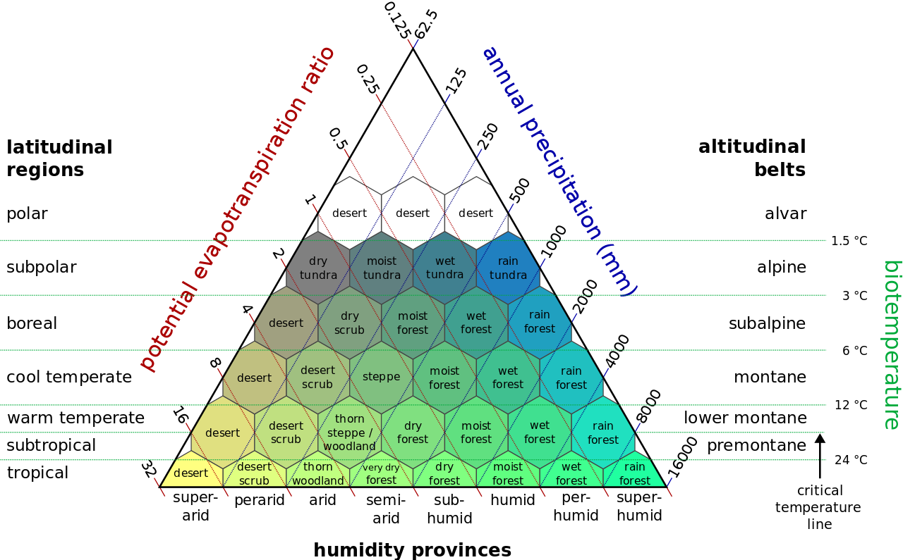
Holdridge life zones- Terrestrial Ecosystems
Notes:
Ecosystems themselves can be seen a Macro niches. Terrestrial ecosystems are primarily defined by the amount of sunlight and water available to them. The Holdridge life zones show how ecosystems are distributed based on those two factors. The organisms of one ecosystem usually do not interact with organisms of the other. In effect, each of these ecosystems are like a very rough niche (not an exact niche as a niche is usually associated with one organism) of the organisms that reside in it.

Slide 10
Energy and Nutrient Flow in an Ecosystem
Energy flows through the ecosystem in one direction.
On the other hand, matter moves through ecosystem in numerous cycles. The nutrients that organisms needs to grow, live, and reproduce are continuously taken from the abiotic environment, consumed, and then recycled back to the environment.
There are several such biogeochemical cycles(with biological, geological and chemical interaction), powered directly or indirectly by solar energy. They include Water cycle, Carbon cycle, Oxygen cycle, Nitrogen cycle, Phosphorous cycle.
Earth is essentially closed system- matter can not escape from its boundaries.
Notes:
Now, lets discuss the energy and nutrient flow in an ecosystem. Energy flows only in one direction but matter (nutrient) cycles around the system through both abiotic and biotic components in the ecosystem. We encapsulate the nutrient flows through biogeochemical cycles.

Slide 11
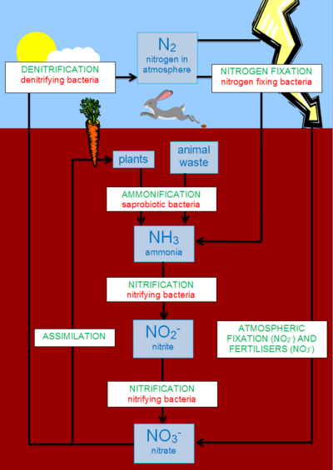
Biogeochemical cycle
Notes:
The nitrogen cycle is an example of the biogeochemical cycle. It shows the cycling of nitrogen through the abiotic and biotic components of the ecosystem.

Slide 12
Food Chains
The producers, consumers, and decomposers of each ecosystem make up a food chain.
There are many food chains in an ecosystem.
Food chains show how energy is transferred and not who eats who
Notes:
As nutrient cycling is represented through biogeochemical cycles, the energy transmission is represented through food chains. Please keep in mind though that food chains for most cases are hypothetical. In real life, an ecosystem consists of many food chains which are very interlinked and its nearly impossible to take them apart.

Slide 13
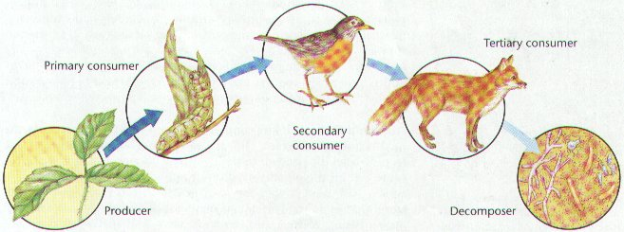
Example of a Food Chain
Notes:
Please note here that the plant doesn’t eat the sun. Similarly many decomposers do not eat the dead. They have a different mechanism to process energy and nutrients.

Slide 14
Food Web
Many food chains overlap, since most organisms have more than one item on their menu. Again an organism can be found on the menus of many other organisms. Thus we have a complex network of interconnected food chains, which is called as Food Web.

Slide 15
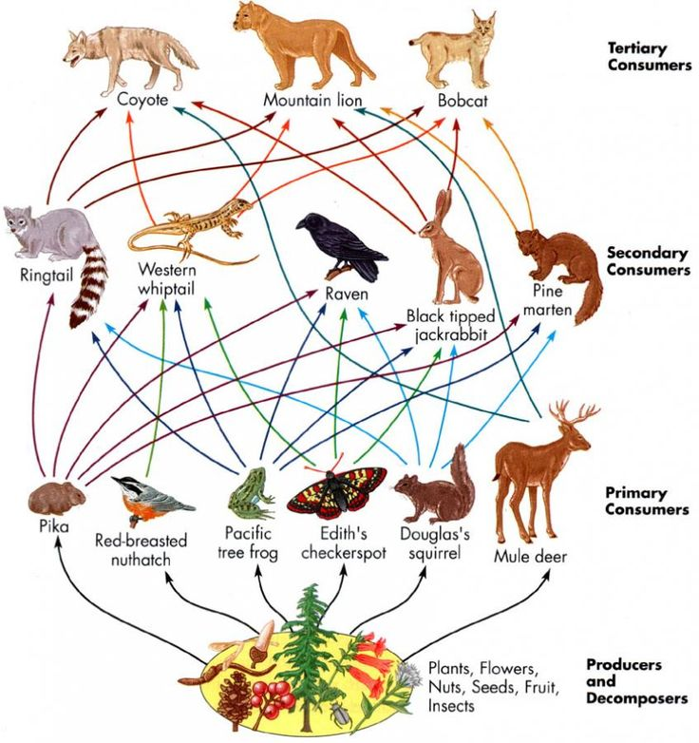
Notes:
Food webs consist of various levels (producers, primary consumers etc.) in it and show how energy is transferred from one to another in an ecosystem. A food chain is a single vertical cross-section of a food web. It is a necessary that the 1st level has more energy than the second and the second level has more energy than the third for Law of conservation of energy to be valid. But if you look at the diagram, the energy possessed in the tertiary consumers (weight of coyote+lion+bobcat) is more than the combined energy present in the secondary consumers level. This is similarly true between secondary consumers and primary consumers. How is this possible? Think about this for a minute. (answer below)
Solution: Though the weight of coyote+lion+bobcat in the tertiary consumers level is more than the individual weight of organisms in the secondary consumers level, the ecosystem is not composed of only one of each organism. An ecosystem will carry far bigger population of organisms in the secondary consumers level than in the tertiary consumers. The combined weight of population of each organism in the secondary consumers level will necessarily be larger than the combined population of organisms in the tertiary consumers level. This is how ecosystems guide productivity and stabilization. A higher level organism will necessarily evolve to have fewer offspring and have a lower population than an organism in the lower levels. And the higher the amount of energy available in the producers level will dictate the amount of diversity present in the rest of the levels.

Slide 16
Understanding Food webs-Trophic Levels
A trophic level is the position occupied by an organism in a food chain.
Trophic levels can be analyzed on an energy pyramid.
Producers are found at the base of the pyramid and compromise the first trophic level.
Primary consumers make up the second trophic level.
Secondary consumers make up the third trophic level.
Finally tertiary consumers make up the top trophic level.
Notes:
The levels we were referring to in the food webs are called trophic levels. In a food chain, only one organism is present in one trophic level. In a food web, multiple organisms exists in a trophic level. Each organism in any given trophic level does the same function from the perspective of energy transfer in the ecosystem.

Slide 17
Biomass
Energy is sometimes considered in terms of biomass, the mass of all the organisms and organic material in an area.
There is more biomass at the trophic level of producers and fewer at the trophic level of tertiary consumers.
Bio=life Mass=weight
Bio + Mass = Weight of living things within an ecosystem.
Notes:
Biomass is the weight of all living things in an ecosystem. An interesting question is how does one actually go about calculating this? For example, what is the biomass of the Western Ghats? Would you go about measuring the weight of everything in the Ghats? That’s simply not possible. Think about this for a minute.
Solution: To measure the weight of an entire biome or an ecosystem, we divide the entire area into a grid of some size (determined through some statistical tools). We then randomly select required amount of boxes (determined through statistical analysis) and then go to those actual areas and record the frequency/area of all life forms and measure the weight of some individuals (again the number of individuals required is preset through some statistical analysis) of each organism. Once we finish this for all selected boxes, we get an idea of rough population of each organism. We then simply multiply the average measured weight of each organism to the population to get weight of the entire ecosystem.

Slide 18
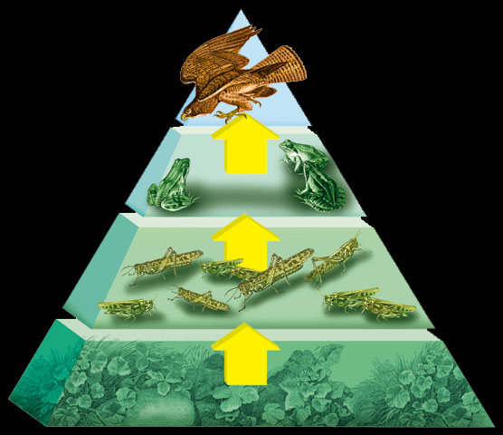
Energy/Biomass Pyramids
The greatest amount of energy/biomass is found at the base of the pyramid.
The least amount of energy/biomass is found at top of the pyramid.
Notes:
Energy pyramids are very useful. They are not only used for visual representation of energy transfer in the ecosystem but are also used to approximate the health of an ecosystem.

Slide 19
Assessing Health of Ecosystems Through Energy/Biomass Pyramids
A energy/biomass pyramid can never be inverted for a healthy “closed” ecosystem
The slope and the trophic levels of the pyramid can be approximated for a healthy ecosystem (different ecosystems will have different constituent in each trophic level and slope in the energy/biomass pyramid).
A significant deviation from the approximated norm can point to serious problems in an ecosystem

Slide 20
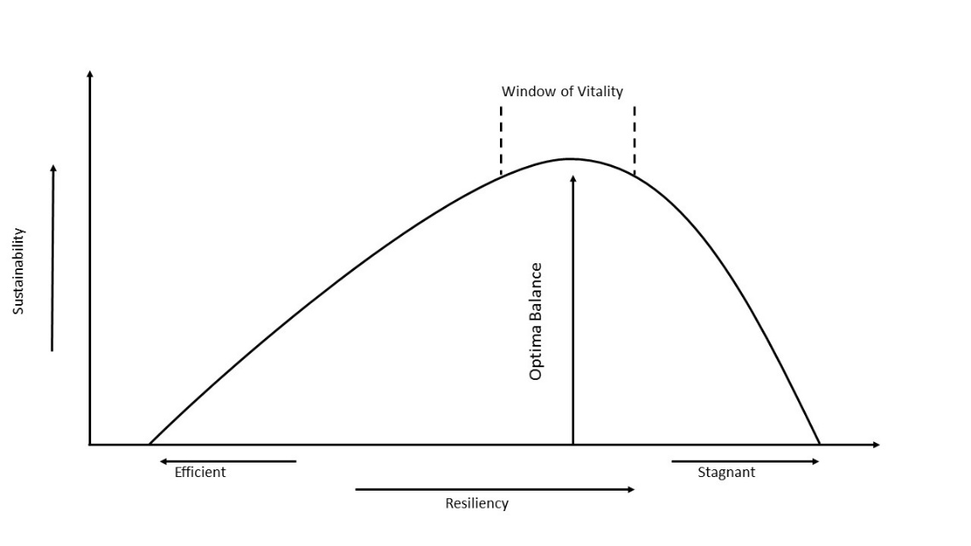
Health of Ecosystems: A complex systems perspective
Adapted from Goerner et al., 2009
Notes:
Another way to understand the health of an ecosystem is by looking at it as a complex system. A complex system is defined as a system that is composed of many components which interact with each other in often unexpectable ways and in a non-linear fashion to show emergent behavior (unexpected behavior) and spontaneous order (they show some unexpected pattern in otherwise what looks like chaos). These factors make such systems very difficult to model or simulate on a computer. Ecosystems are a classic example of a complex system where each component in the system is the biodiversity it hosts.
When a complex system has few components, it is known as a “efficient system” as it can transmit anything through it with very little loss. But it is also very susceptible to collapse if a few components fail and hence have very low sustainability ( meaning Complex systems which are efficient, usually fail more often). On the flipside, if the system has too many components, it becomes a “stagnant system” as there is a lot of loss from whatever it is that you are trying to transmit through the system and hence again have very low sustainability. But they are very resilient to changes as they can withstand failure of many components in them.
As research has shown in the graph above, most stable ecosystems occupy a space called the “window of vitality” where they have just the right amount of biodiversity that allows them good sustainability and also resiliency. Any changes to the biodiversity to the ecosystem can push it away from this window of vitality and accelerate their demise. This is another reason why biodiversity of ecosystems need to be protected.

Slide 21
BIODIVERSITY
The term biodiversity refers to the totality of species, populations, communities and ecosystems, both wild and domesticated that constitute the life of any one area or of the entire plant.
Degree of variety in life in an ecosystem

Slide 22
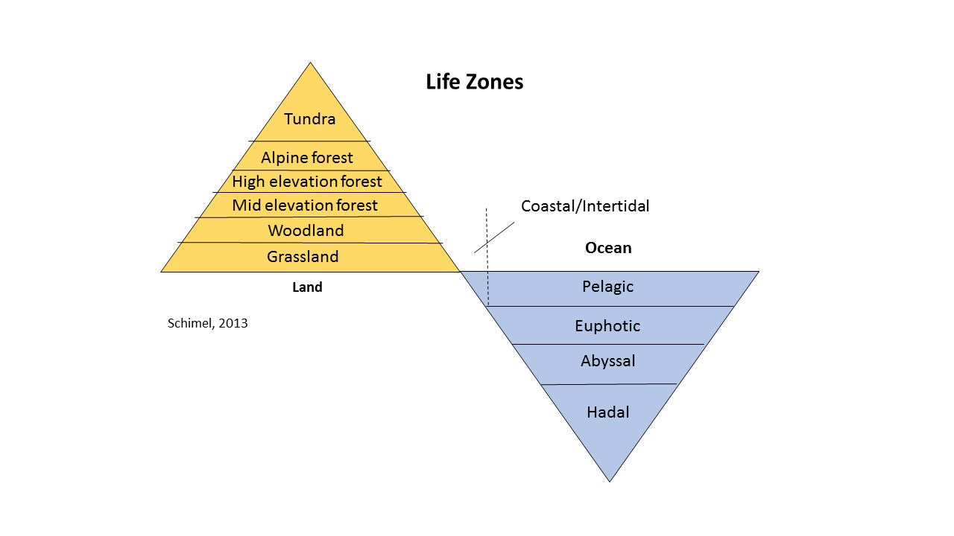
Relationship between altitude, ecosystem and biodiversity- Holdrige Life zones
Notes:
Holdridge life zones generally encapsulates the amount of life present in various ecosystems. Grasslands and pelagic zone of the oceans have the most diversity and the diversity, generally speaking, reduces as you move away from the mean sea level.

Slide 23
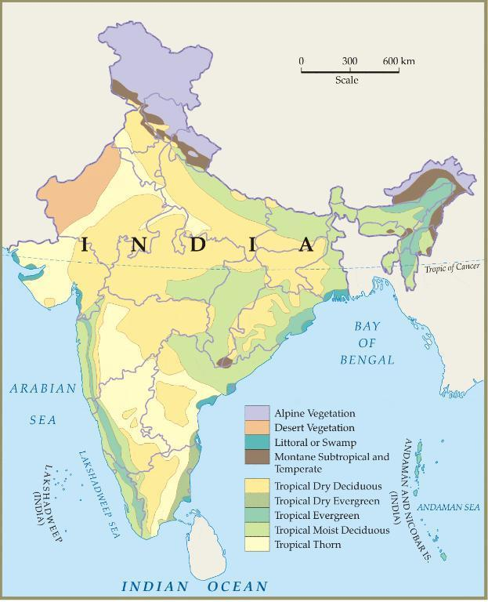
INDIA’S BIODIVERSITY
India is home to 33% of the life forms found in the world, 2 % of the world landmass 8% of the biodiversity of the world.
More than 18000 plants
1337 birds
More than 400 mammals
More than 600 reptiles and amphibians
60% of this wealth can be found in the Western Ghats
TNAU
Notes:
India is home to one of the richest biodiversity in the world. This biodiversity is crucial to balancing the ecosystems and sustain life on this sub-continent. Unfortunately, many organisms are being threatened with extinction due to man-made issues. It is therefore important to conserve them before they disappear and alter the balance of crucial ecosystems. For this, we need to be able to prioritize which parts of the biodiversity need more immediate attention so that we can conserve them first. We do this with the help of IUCN red list.

Slide 24
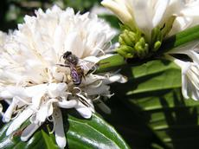
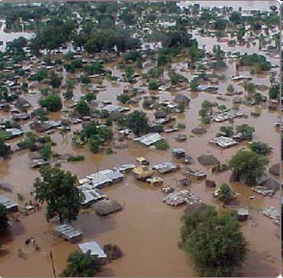
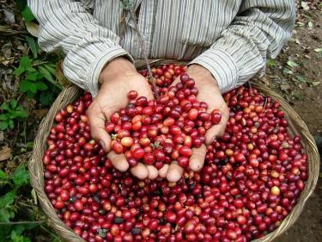
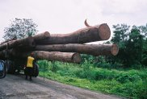
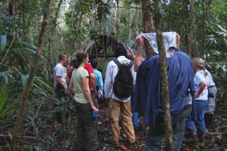
Natural systems provide society with many goods and services: ecosystem services
Pollination
Flood control
Non-timber forest products
Raw materials
Recreation
Gallai et al, 2009
Notes:
Natural ecosystems provide us with a variety of services, including supporting pollination of our crops, which is thought to be worth over 110 billion USD per year globally. (Gallai et al. Ecological Economics), raw materials (Timber alone is responsible for 200 billion globally) and countless other services.

Slide 25
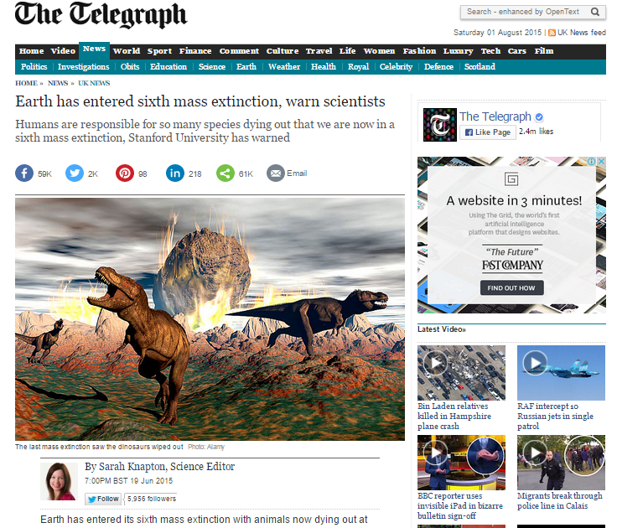
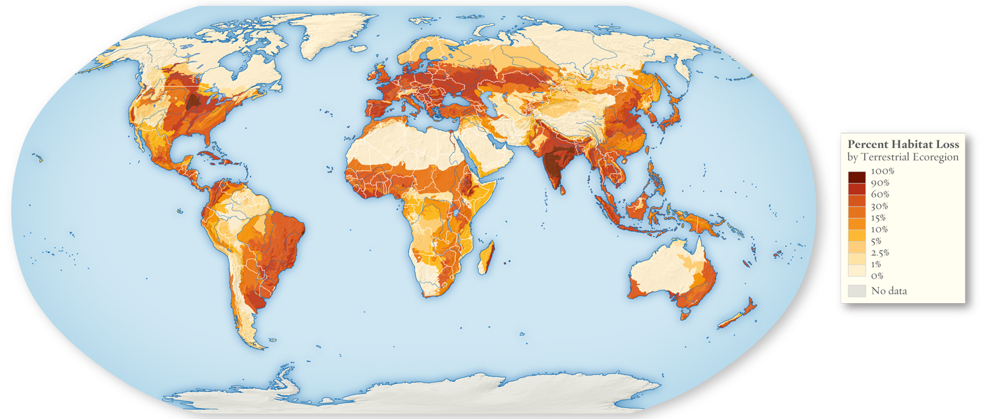
Extinction
Williams, 2013
Notes:
Unfortunately, we are slated to lose many of these services due to the looming extinction threat to many species in our ecosystems. India is particularly prone to extinction due to extensive habitat loss and climate change.

Slide 26
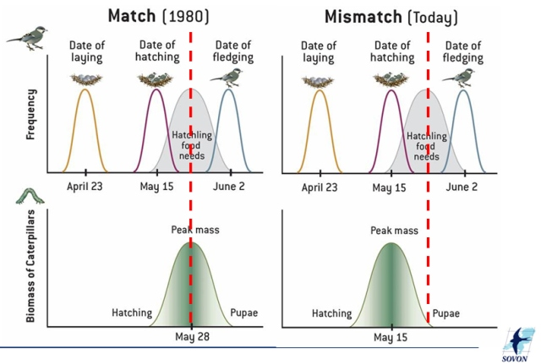
Effect of climate change- Trophic Mismatch
Notes:
Another important factor affecting biodiversity is climate change, through a phenomenon known as trophic mismatch. The above is an example of what is known as a temporal trophic mismatch. Here, climate change is affecting the timing on which many animals rely on to maximise their productivity. In this example, birds find their mates, build nests and lay eggs so that they can hatch at the time when caterpillars are the most abundant in the ecosystem. This ensures that maximum number of their off springs receive adequate amount of food to grow well, build stores they might need for migration and succeed in becoming productive adults. Getting this timing right is very crucial for the survivability of many species like the bird in this example. Climate change is causing havoc to this temporal balance. The prevailing thought in research is that many species are not probably able to keep pace with this timing mismatch and which will eventually have an effect on their productivity.

Slide 27

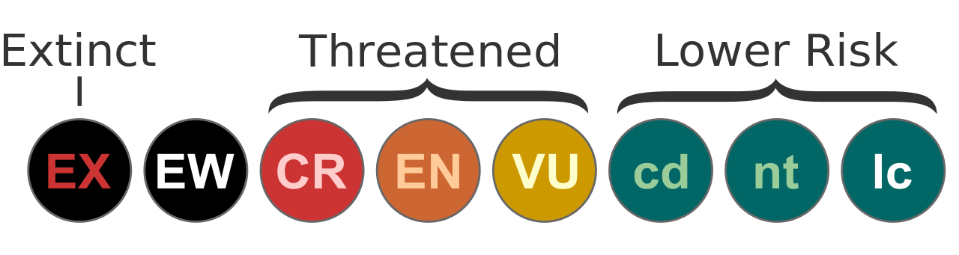
Biodiversity Conservation
Source: Wikimedia
Source: Wikimedia
Notes:
International Union for Conservation of Nature (IUCN) Red list founded in 1964 as a list of flora and fauna whose extinction risk was assessed using set of defined criteria and categories. Since then, it has become the most comprehensive list of conservation status of species around the world. The main purpose of creating this list is to assess the extinction risk of all known species and sub-species, bring to attention the ones which are in most dire need of conservation and, influence international and national policy to conserve biodiversity. The criteria and categories used in the red list have their roots in robust scientific principles and can be applied anywhere in the world without any changes. Each species in red list undergoes an evaluation every 5 years, or at minimum every 10 years to reassess their extinction risk through a peer review process.
Full report can be read here: https://portals.iucn.org/library/sites/library/files/documents/RL-2001-001-2nd.pdf

Slide 28
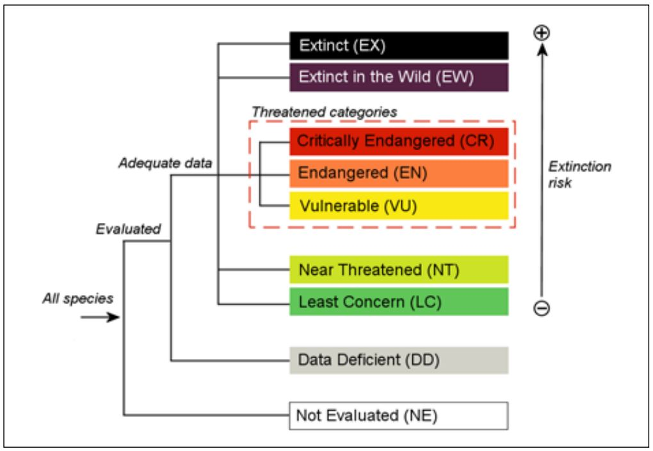
IUCN Red List Categories
Source: IUCN
Notes:
This is how the various extinction risk levels are assessed:
According to this report,
Extinct (EX) – A taxon is no longer extant in its known or expected habitat at appropriate times beyond reasonable doubt.
Extinct in the wild (EW) – A taxon survives only in captivity, cultivation and/or as naturalized population outside its native range, as presumed after exhaustive surveys.
Critically endangered (CR) – A taxon is in an extremely critical state if it meets all set out for this category in the red list and is therefore facing extremely high probability of extinction in the wild
Endangered (EN) – A taxon is in this state if it meets all set out for this category in the red list and is therefore facing high probability of extinction in the wild
Vulnerable (VU) – A taxon is in this state if it meets all set out for this category in the red list and is therefore facing some degree of threat of extinction in the wild.
Near threatened (NT) – A taxon is close to being at high risk of extinction in the near future.
Least concern (LC) – A taxon is unlikely to become extinct in the near future.
Full report can be read here: https://portals.iucn.org/library/sites/library/files/documents/RL-2001-001-2nd.pdf

Slide 29
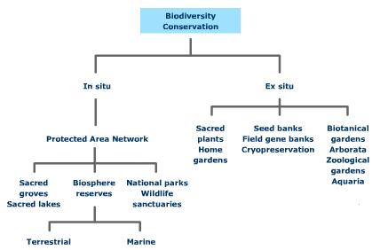
Notes:
Biodiversity conservation can be broadly categorized into two; Insitu or on-site conservation (conservation in their original habitat), and exsitu or off-site conservation (conservation in a built habitat).

Slide 30
In situ Conservation Strategies
It means the conservation of ecosystems, natural habitats and the maintenance and recovery of viable populations of species in their natural surrounding and in the case of domesticated or cultivated species, in the surroundings where they have developed their distinctive properties.

Slide 31
Protected areas:
These are the areas of land and/or sea, especially dedicated to the protection and maintenance of biological diversity and of natural and associated cultural resources.
Maintaining viable populations of all native species and subspecies.
Maintaining the number and distribution of communities and habitats and conserving the genetic diversity of all the existing species.
Preventing man created introduction of exotic species.
Making it possible for species to shift in response to environmental changes.

Slide 32
Ex situ conservation strategies :
It is defines as the conservation of components of biological diversity outside their natural habitat.
Eg:- Botanical gardens, zoos, aquaria, gene banks, seed banks, use of biotechnology and DNA preservation.
Botanical gardens and zoos:-
There are more than 1500 botanical gardens and arboreta in the world with more than 80000 species.
Similarly there are more than 800 professionally managed zoos around the world with about 3000 species.

Slide 33
Biotechnological methods:-
It has provided many new conservation tools in agriculture, animal husbandry, fisheries, forestry and medicine..
Gene banks:- It provides a method of conservation of diverse genetic resources, particularly of threatened species and those seeds which are not viable for longer periods under natural conditions.
Conservation of DNA:- An emerging and promising technique in preserving biodiversity is isolation and conservation of DNA. It can be used for endangered or even extinct species by taking samples of material from hair, bones and herbarium specimens of the target species.

Slide 34
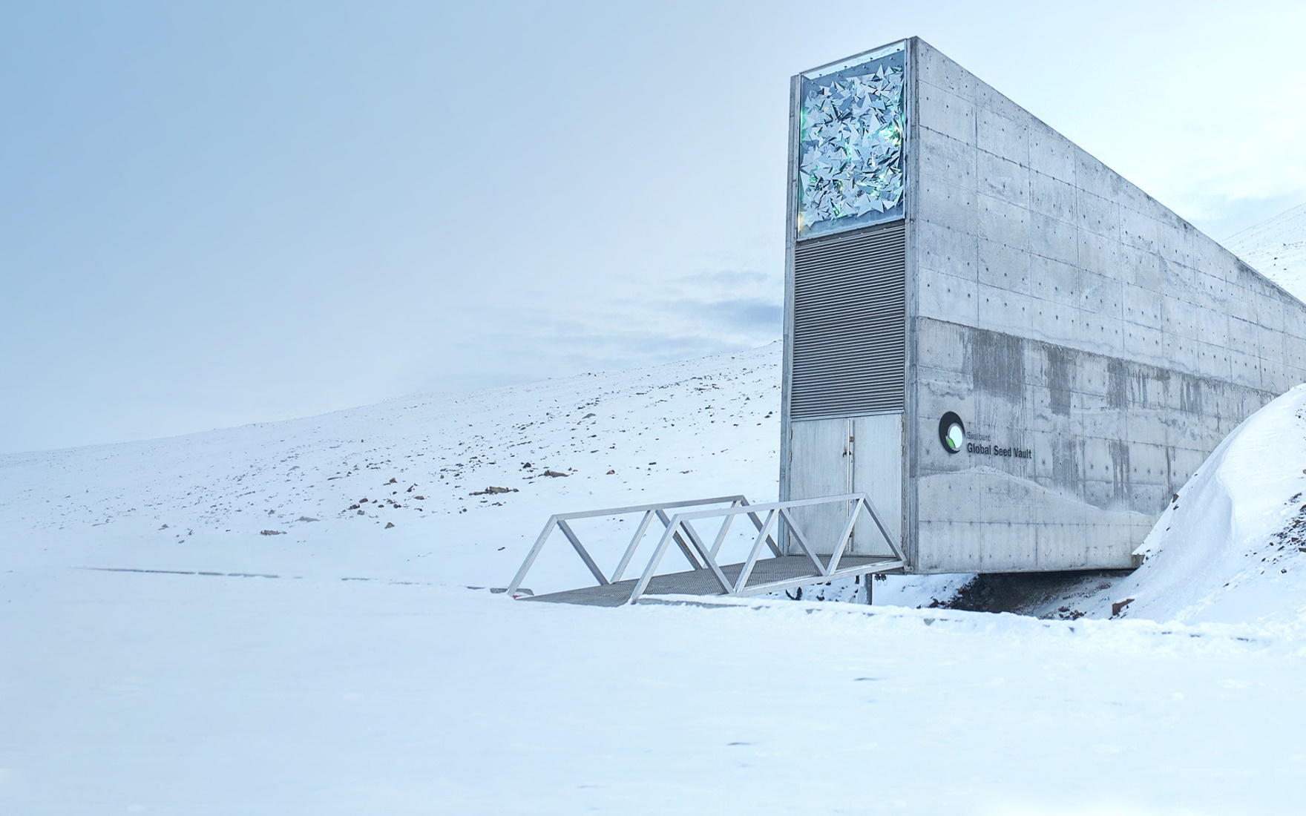
SVALBARD GLOBAL SEED VAULT
CROPTRUST.ORG
Notes:
Svalbard global seed vault is an underground secure seed vault on an isolated island in Norway. Its primary purpose is to ensure that there is no absolute floral diversity loss due to a national or global crisis. This is especially important to maintain crop seeds which are important to reboot the agricultural industry after a disaster.

Slide 35
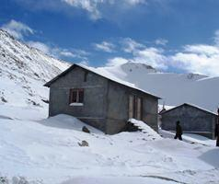
Chang-la Gene bank, Leh
India commissioned its own seed bank called the Chang-la Gene Banks for long-term storage of crops germplasm at a permanently frozen mountain in Leh. It’s the second seed bank in the world after Svalbard.
natureasia.com

Slide 36
Problems in Conservation:-
Very little understanding of what is to be conserved, especially with regard to complex natural ecosystems like tropical rain forests.
Limited Financial resources to protect and manage ecosystems.
Alienation of people from their natural resources bring in resentment among local people and no protected area.
Notes:
Prepared by Shaurya Rahul Narlanka

